Slide 1


Outcome Based Education
Presents
Session for Students on
By:
Mr. Shakir Karim
Assistant Professor
Convener, DCQIC
DoCS&IT

Slide 2

Outcome Based Education (OBE) What?
Program Educational Objectives (PEO)
Few years after
Graduation – 4 to 5 years
Program Learning Outcomes (PLO)
Upon graduation
Course/subject Outcomes (CLO)
Upon subject completion
Weekly/Topic Outcomes
Upon weekly/topic completion
Computer Science & Information Technology Department
Sir Syed University of Engg. & Tech.
Presented by: Mr. Shakir Karim

Slide 3
Outcome Based Education (OBE) Why?
Why OBE?
It offers a framework to learn and deliver the acquired skills.
Studies say that OBE results in increased student and teacher self-esteem, higher academic success for more students, decreased dropouts, and several other benefits
Flexibility
Transparency
Precision
Comparison
Self Development and Career Progression
Computer Science & Information Technology Department
Sir Syed University of Engg. & Tech.
Presented by: Mr. Shakir Karim

Slide 4
Outcome Based Education (OBE) Process
Follows Seoul Accord (an international agreement)
OBE Implementation Process
Map Program Educational Objectives with PLO
Define Course Learning Objectives (CLOs)
Mapping of CLOs with PLOs and BT Levels
Computer Science & Information Technology Department
Sir Syed University of Engg. & Tech.
Presented by: Mr. Shakir Karim

Slide 5
Outcome Based Education (OBE) Success in academics
Three pillars for success in academics
Student’s Willingness
Academic
Success
Teacher’s Excellence
Parents Support
Computer Science & Information Technology Department
Sir Syed University of Engg. & Tech.
Presented by: Mr. Shakir Karim

Slide 6
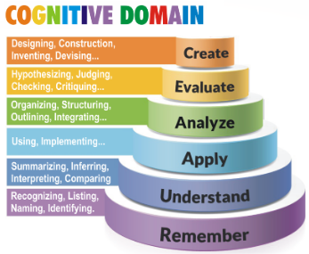
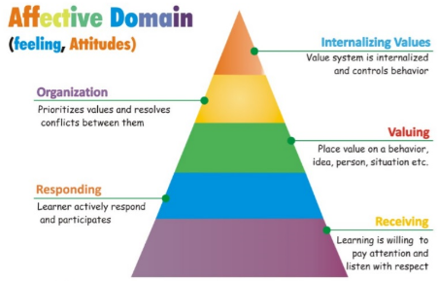
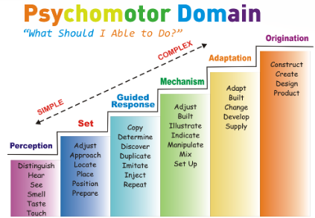
Outcome Based Education (OBE) Assessment Criteria
Students are assessed on the basis of
Cognitive Skills (mostly Theory)
Affective / Social Skills (mostly Lab)
Psychomotor Skills (mostly Lab)
Computer Science & Information Technology Department
Sir Syed University of Engg. & Tech.
Presented by: Mr. Shakir Karim

Slide 7
Outcome Based Education (OBE) Details of OBE including
Details of OBE includes :
Program Learning Outcomes (PLOs),
Course Learning Outcomes (CLOs),
Relationship of Assessment Tools and CLOs,
Format of Assignments/Quizzes/Exam Papers
Course Analysis Report (CAR)
Computer Science & Information Technology Department
Sir Syed University of Engg. & Tech.
Presented by: Mr. Shakir Karim

Slide 8
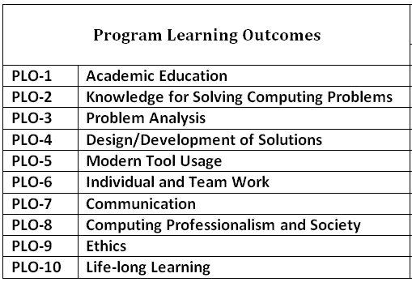
Outcome Based Education (OBE) Program Learning Objectives (PLOs)
Computer Science & Information Technology Department
Sir Syed University of Engg. & Tech.
Presented by: Mr. Shakir Karim

Slide 9
Outcome Based Education (OBE) KPIs for PLOs
PLOs (1 to 10) | Measurement Tool | Key Performance Indicator | Measurement Time
Student PLO assessment | Attainment via assessment of CLOs to particular PLOs. (Direct) | At least obtain 50% in each PLO upon graduation | At the end of each semester
*(KPI) for CLO: At least obtain 50% in each CLO
Computer Science & Information Technology Department
Sir Syed University of Engg. & Tech.
Presented by: Mr. Shakir Karim

Slide 10
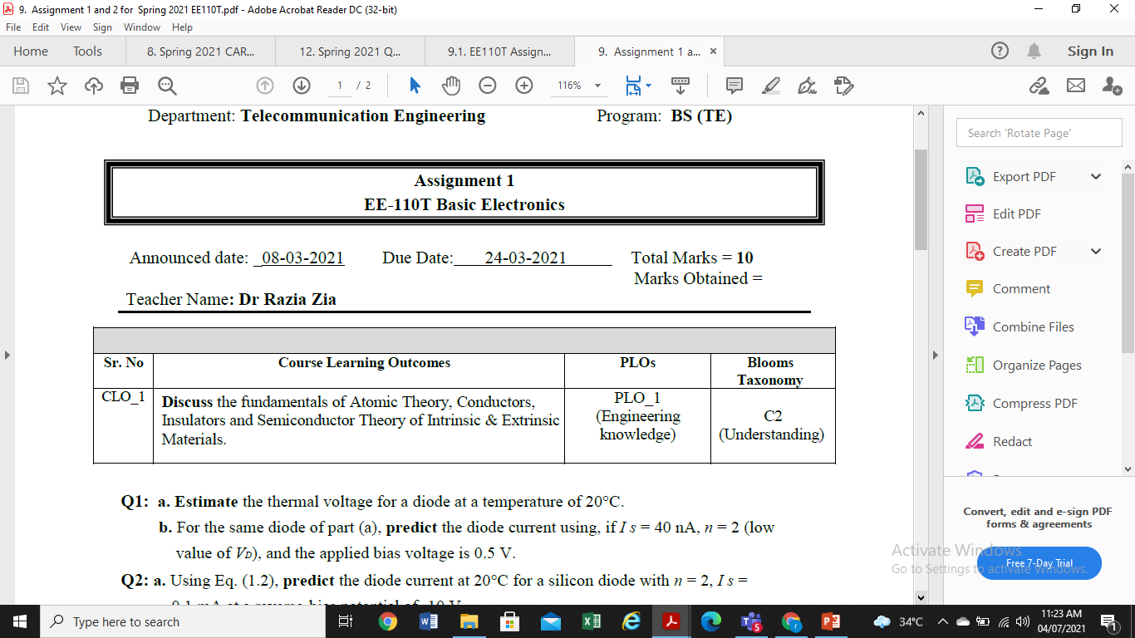
Outcome Based Education (OBE) Assessment Tools and CLOs
Assignments and Quizzes
Courtesy: Dr. Razia Zia, Asst. Prof. (Electrical Engineering Department)
Computer Science & Information Technology Department
Sir Syed University of Engg. & Tech.
Presented by: Mr. Shakir Karim

Slide 11
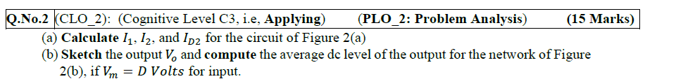
Outcome Based Education (OBE) Assessment Tools and CLOs
Midterm, Final, and Lab Exams
Final/ Midterm Paper
Courtesy: Dr. Razia Zia, Asst. Prof. (Electrical Engineering Department)
Computer Science & Information Technology Department
Sir Syed University of Engg. & Tech.
Presented by: Mr. Shakir Karim

Slide 12
Outcome Based Education (OBE) Relationship of Assessment Tools and CLOs
From the Course Information Sheet (CIS):
-Discuss the CLOs of the course
-Discuss the relationship of assessment tools with CLOs
Courtesy: Dr. Razia Zia, Asst. Prof. (Electrical Engineering Department)
Computer Science & Information Technology Department
Sir Syed University of Engg. & Tech.
Presented by: Mr. Shakir Karim

Slide 13
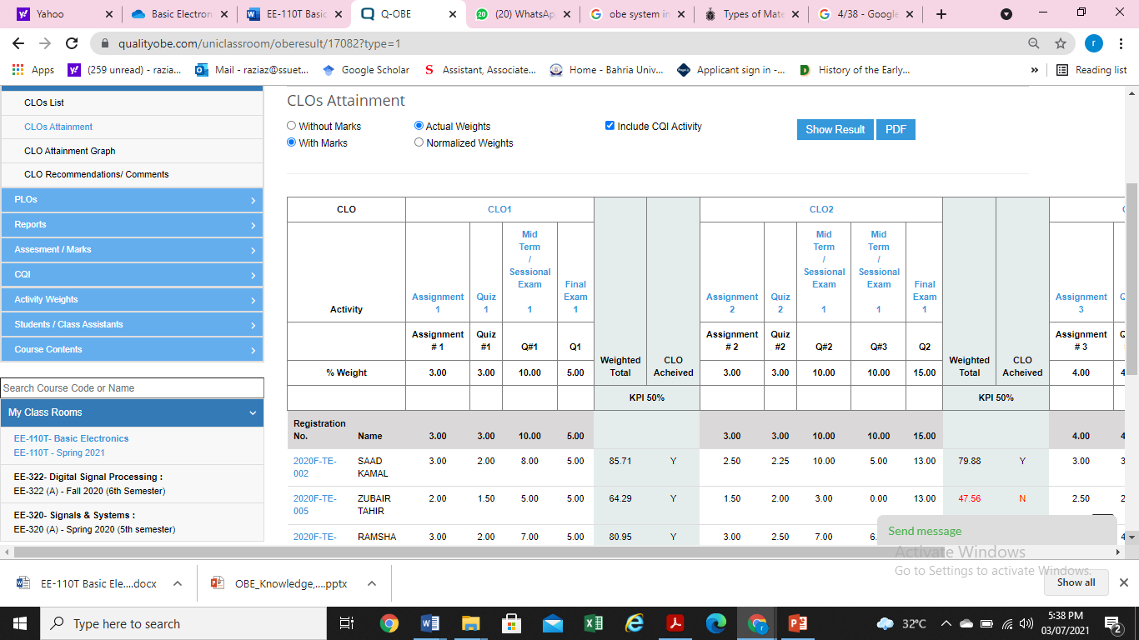
CLO Attainment of Individual Student
Courtesy: Dr. Razia Zia, Asst. Prof. (Electrical Engineering Department)
Computer Science & Information Technology Department
Sir Syed University of Engg. & Tech.
Presented by: Mr. Shakir Karim

Slide 14
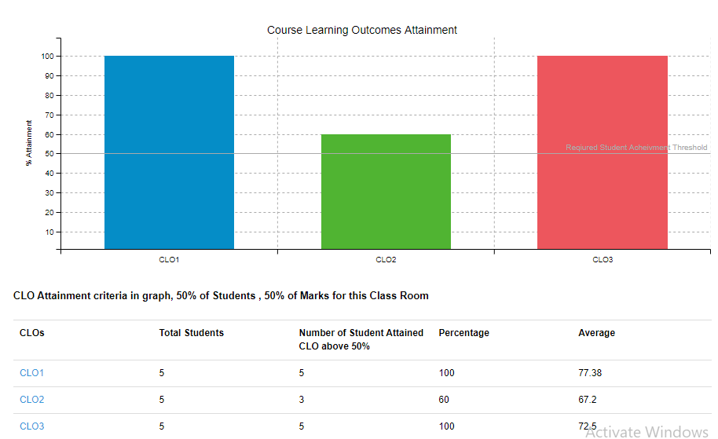
CLO Attainment on Cohort (group) level
Courtesy: Dr. Razia Zia, Asst. Prof. (Electrical Engineering Department)
Computer Science & Information Technology Department
Sir Syed University of Engg. & Tech.
Presented by: Mr. Shakir Karim

Slide 15
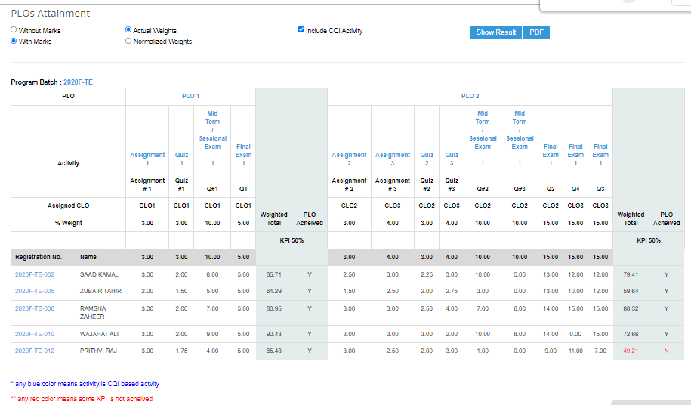
PLO Attainment of Individual Student
Courtesy: Dr. Razia Zia, Asst. Prof. (Electrical Engineering Department)
Computer Science & Information Technology Department
Sir Syed University of Engg. & Tech.
Presented by: Mr. Shakir Karim

Slide 16
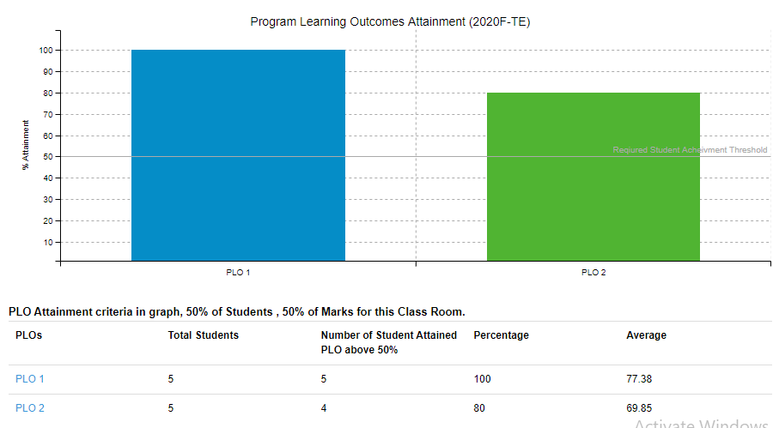
PLO Attainment on Cohort (group) Level
Courtesy: Dr. Razia Zia, Asst. Prof. (Electrical Engineering Department)
Computer Science & Information Technology Department
Sir Syed University of Engg. & Tech.
Presented by: Mr. Shakir Karim

Slide 17
Important Note !!!
PLO attainment and CLO attainment
Students should try to achieve at least 50% in each CLO of a course
In case of failure to achieve 50%, students will be issued a warning, Even they passed the course
For those students who passed the course BUT obtained less than 50% in a CLO, they will be given an ungraded assignment
Computer Science & Information Technology Department
Sir Syed University of Engg. & Tech.
Presented by: Mr. Shakir Karim

Slide 18
Conclusion
Outcome Based Education
promotes student-centered learning
encourages active engagement, critical thinking, and lifelong learning
equips students with the necessary tools to succeed,
helps students to thrive in an ever-changing world.
"Outcome Based Education: Empowering learners with Excellence."
*(KPI) for CLO: At least obtain 50% in each CLO
Computer Science & Information Technology Department
Sir Syed University of Engg. & Tech.
Presented by: Mr. Shakir Karim

Slide 19
This is only the Beginning !
Questions are welcome…
Program Educational Objectives (PEO)
Few years after
Graduation – 4 to 5 years
Program Learning Outcomes (PLO)
Upon graduation
Course/subject Outcomes (CLO)
Upon subject completion
Weekly/Topic Outcomes
Upon weekly/topic completion
*(KPI) for CLO: At least obtain 50% in each CLO
Computer Science & Information Technology Department
Sir Syed University of Engg. & Tech.
Presented by: Mr. Shakir Karim

